Slide 1
VS theoretical overview ©copyright ERA 2013
The implicate order & Our relationship with the real
“All knowledge has its origins in perception” Leonardo Da Vinci

Slide 2
From…….

Slide 3
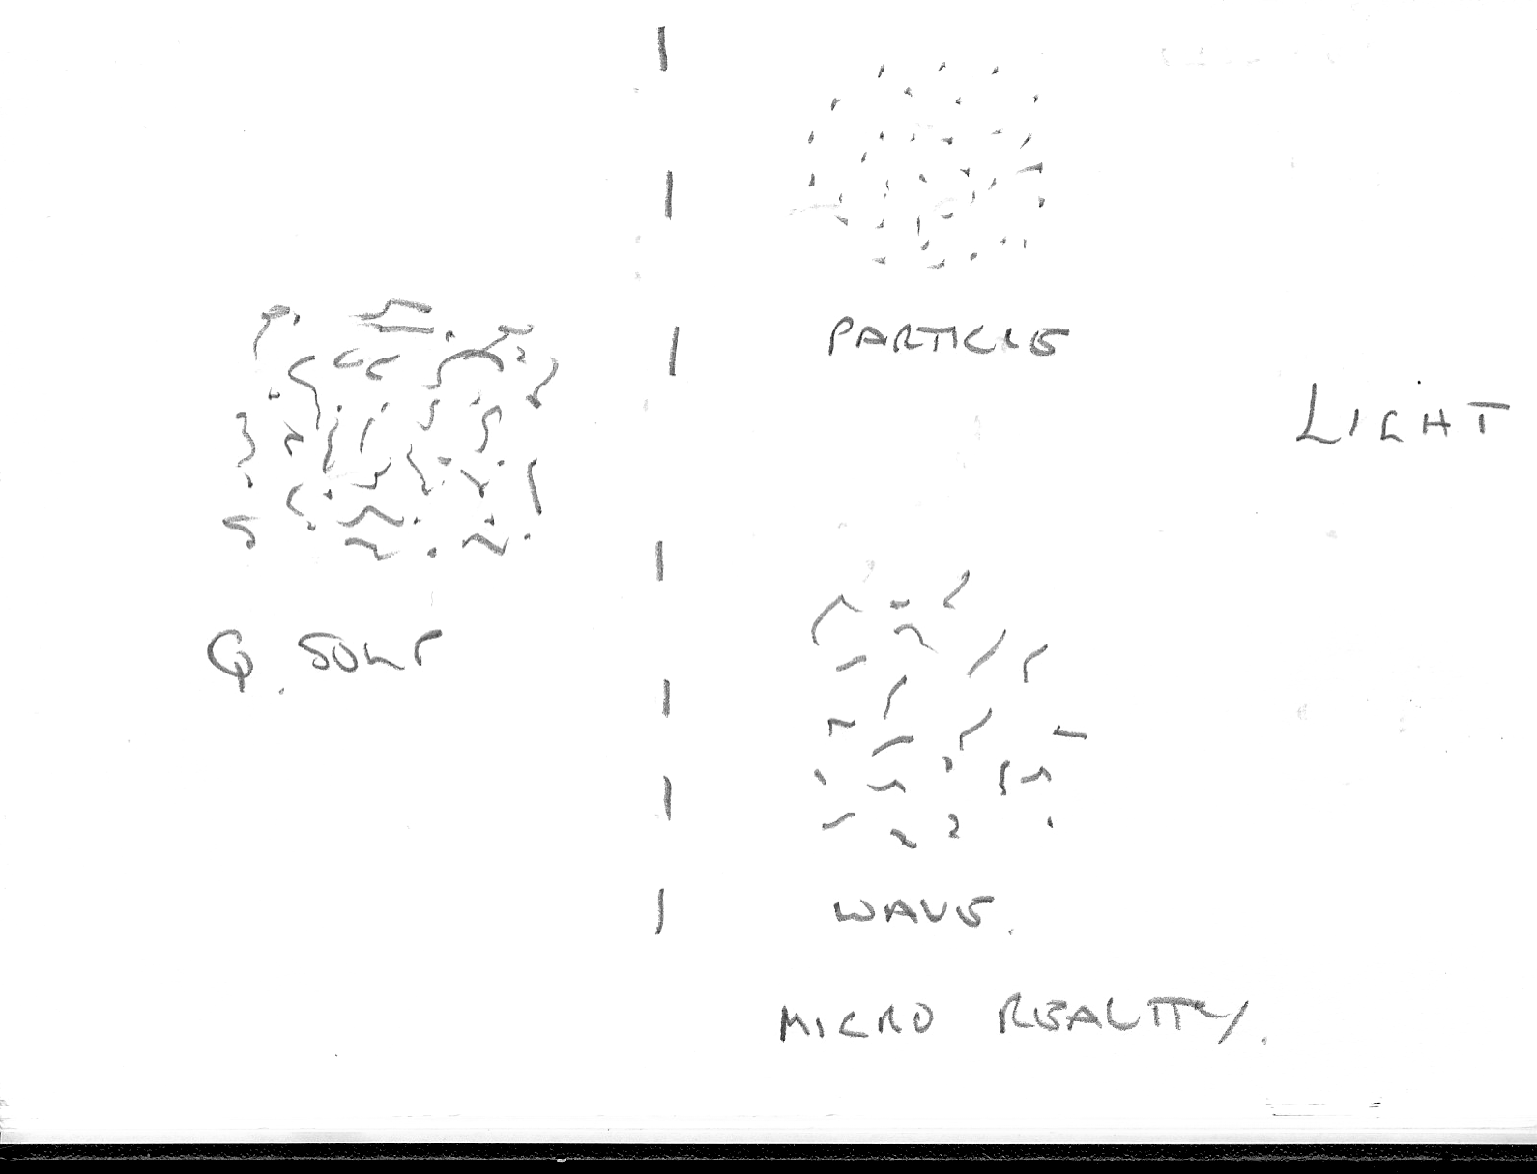
Free moving micro particles come into existence and fall back into the soup!
Is there an individual physical ‘reality’ to the micro conditions of wave and particle?

Slide 4
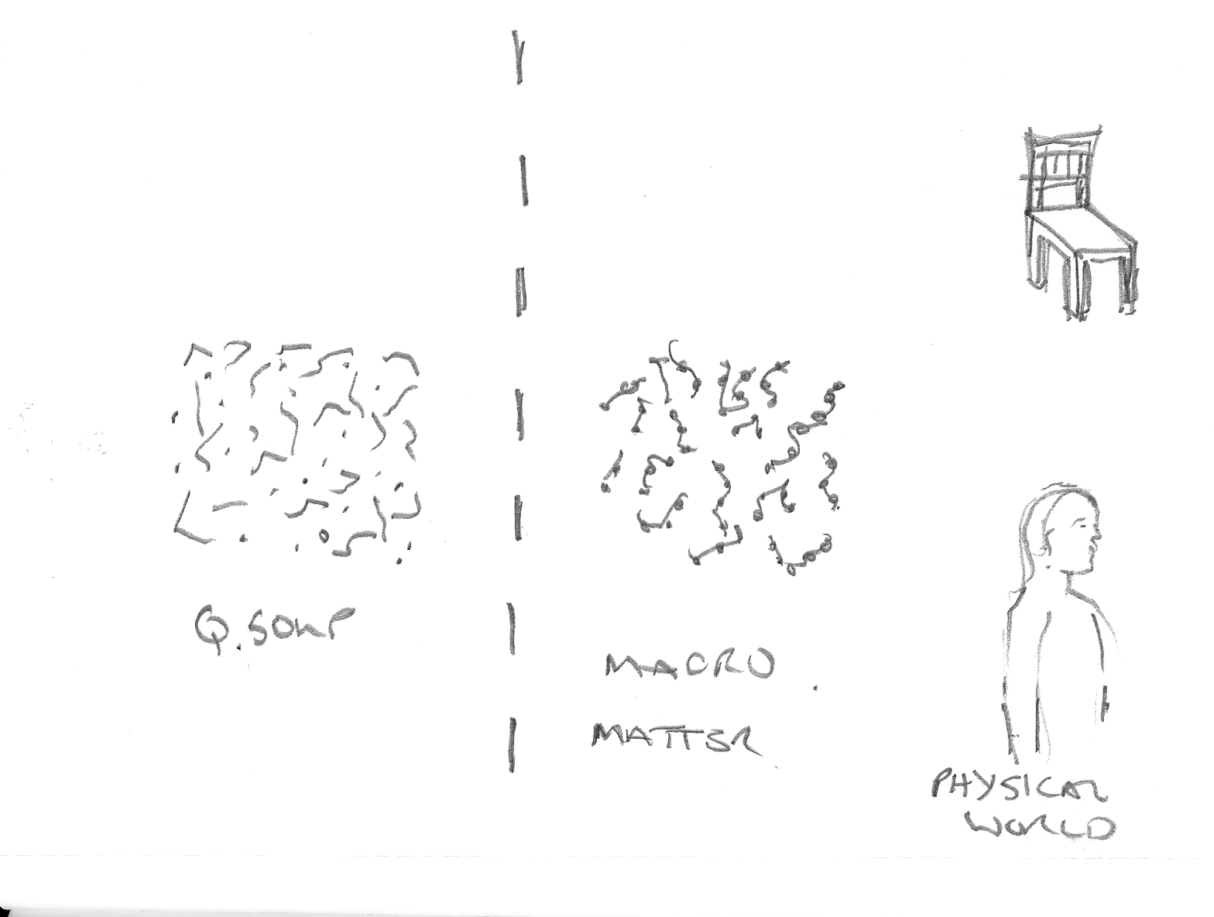
Free moving micro particles come together forming atoms, molecules and chairs and us!!
There comes into play a division or membrane between the micro and macro states

Slide 5
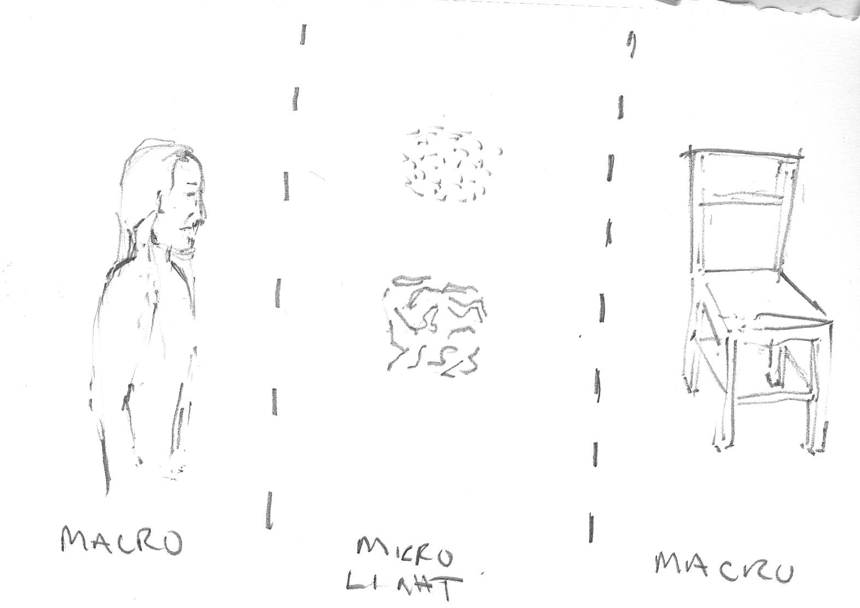
We (macro object) can only see the macro chair via light belonging to the micro condition
Are there two potential versions of micro reality caught up in the light array?

Slide 6
Micro – photons, free moving micro particles
Macro – physical objects, real settings and us
Micro Macro divide or membrane: Zone of interaction between states – atomic level, molecules etc

Slide 7
The world of physical objects and our visual interaction and perception of them involves all 3 categories
The chair is made of atoms and molecules
Light brings us the data from which we generate a visual impression of the object and its setting

Slide 8
Our visual senses rely on free moving micro particles to deliver an impression of the macro objects and the setting in which they sit
Light array – free micro particles
Retina - membrane
We are familiar with the rectilinear propagation of light as optical projection
We tend to associate this in some way with visual perception.
Is this just of the potential data-sets that we receive of the environment?

Slide 9
Intuitive examination of phenomenal field suggests that there are two independent ‘takes’ on reality operational in phenomenal field
We can trace this potential through the two visual pathways in the brain to the retina
We can propose that a process of decoherence is taking pace within the retinal processing structures
Retina - deocherence
It is now argued on a theoretical basis that we should break with the Copenhagen agreement and complementarity to recognize the independent physical reality of wave and particle formations.

Slide 10
This scenario would ensure that our eyes and brain engaged in the complex task of developing a viable perceptual structure for the delivery of a ‘unified’ version of the real setting from two very different version of the scene
Retina - decoherence
Resulting visual pathways
The suggestion is that embedded within the light array are two potential impressions (takes on reality) of the real setting, one dependent on the photon orientation (what - explicit) and one dependent on coherence producing a field scenario (where - implicit)

Slide 11
Our perceptual impression of the real setting (vision – phenomenal field)
would be a composite even on an monocular basis
It would require a sophisticated process to mediate the two takes on reality from each eye
Audition
Retina - decoherence
Perceptual
structure
There would be a requirement for a perceptual structure generated by the sentient being (non optical)
This perceptual structure would then form the basis for multi-sense integration

Slide 12
Phenomenal field would be essentially dealing with quantum reality issues as it delivered a mediated version of the real setting
Decoherence will ensure that this process will be conducted on the terms of classical physics but the job description for mind will be to develop a system that operates ‘like’ a quantum system. It will be quantum by proxy
Audition
Retina - decoherence
Mind
Awareness
Perceptual
structure

Slide 13
The new illusionary space of Vision-Space is based on an intuitive and computational appreciation of phenomenal field. It reflects the incompatibilities between the real setting, the transference photon, decohered data-sets, the observer’s visual processes and the proxy non-physical state of ‘mind’
Audition
Retina - decoherence
Mind
Awareness
Perceptual
structure
Visual awareness becomes truly a relationship with the real on multiple levels giving rise its phenomenological status and enabling our embodiment in the environment

Slide 14
The potential for a form of cyclical process? Which way do we face?
In which direction does ‘reality’ lie?
Does it reside through us?
Micro – photons, free moving micro particles
Macro – physical objects, real settings and us
Bohm’s implicate order?
Retina - decoherence
Micro Macro divide or membrane: Zone of interaction between states – atomic level, molecules etc
Mind and awareness forming a new membrane that sits within the implicate order?

Slide 15
“Guarda il lume e considera la sua bellezza. Batti l’occhio e riguardalo. Ciò che di lui tu vedi, prima non era, e ciò che di lui era, più non è. Chi è quel che lo rifà, se ’l fattore al continuo more?”
“Observe the flame of a candle and consider its beauty.
Blink your eye and look at it again. What you see now was
not there before, and what was there before is not there
now. Who is it who rekindles this flame which is always
dying” Leonardo Da Vinci
This can mean almost anything of course but I would like
it resonate here!

